Slide 1
Exercise
Input: 1, 4, 1, 2, 7, 5, 2
  Input values range from 1 to 7.
Fill out the frequency, distribution, and output values.
Values | 1 | 2 | 3 | 4 | 5 | 6 | 7
Frequency
Distribution
1
2
3
4
5
6
7
Output
1

Slide 2
Important Note
Do not see the answer immediately on the next page.
  Try it by yourself, and then compare your result with the answer.

Slide 3
Solution
Input: 1, 4, 1, 2, 7, 5, 2
Values | 1 | 2 | 3 | 4 | 5 | 6 | 7
Frequency | 2 | 2 | 0 | 1 | 1 | 0 | 1
Distribution | 2 | 4 | 4 | 5 | 6 | 6 | 7
1
2
3
4
5
6
7
Output | 1 | 1 | 2 | 2 | 4 | 5 | 7

Slide 4
Counting Sort – Time Efficiency
Time complexity of counting sort is O(n+k) where k is the range of n input numbers.
  If k is less than n, the algorithm can sort the n input numbers in the linear time.
  In many cases, the algorithm is used for a small number k for a large number n.

Slide 5
Counting Sort – Example
Suppose you want to sort the academic records of all elementary school students by age.
  In this case, k is the age range of all students and n is the number of students in the school.
  Since k (= age range) is much smaller than n (= number of students), we can do the sorting in the linear time.

Slide 6
Stability of Counting Sort
An important property of counting sort is that it is stable.
  Numbers with the same value appear in the output array in the same order as they do in the input array.

Slide 7
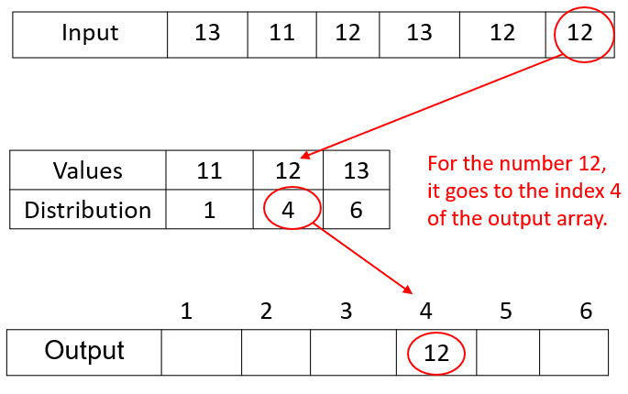
Counting Sort Implementation (1 of 2)
In the previous examples, we assume that the starting index of the output array is “1”.
Example

Slide 8
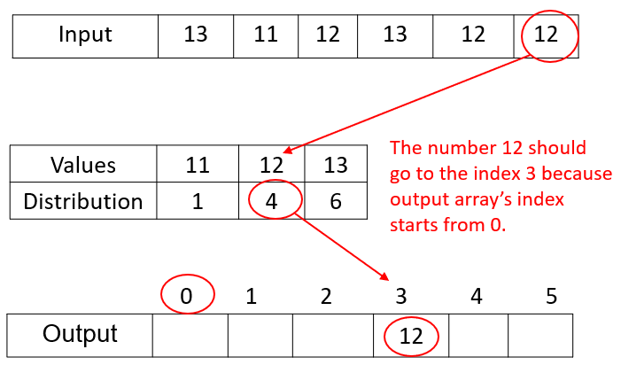
Counting Sort Implementation (2 of 2)
But when implementing it, the output array may be indexed from 0, not 1.
  In that case, you should reduce a distribution value by 1 first. Then, move the input value to the output array.
Example

